Slide 1
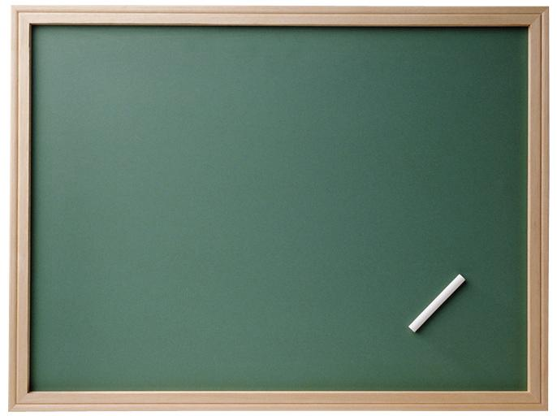
WELCOME
TO
ENGLISH CLASS
AT
Bankhuanyuan School, Trang

Slide 2
Hello. How are you?
Hello. Hello. Hello.
Hello How are you?
I’m fine, I’m fine, I’m fine.
I hope that you are too.
Nice to meet you.
Nice to meet you.
Nice to meet you, too.
Glad to see you. Glad to see you.
Glad to see you, too.

Slide 3
โครงสร้างประโยค:
Where to go ?
Tourist
What to eat ?
What to buy ?

Slide 4
Vocabulary :
place
Excuse me
local product
welcome
tell
nice
great
tourism
buy
visit
try
kind
yummy

Slide 5
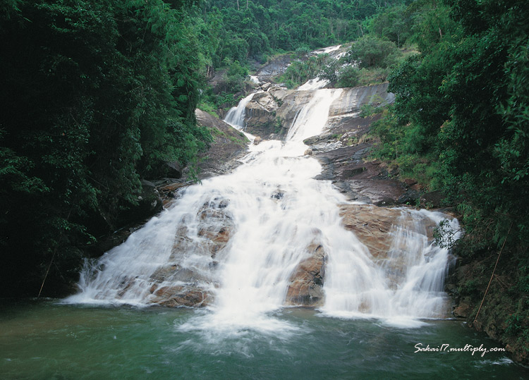
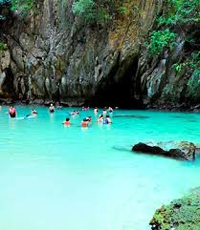
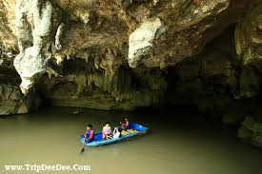
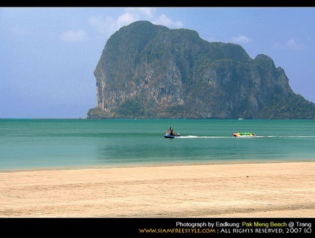
Sai Rung Waterfall
Morakot Cave
Where to go ?
Places in hometown
Khao Kop Cave
Pak Meng Beach

Slide 6
conversation
Student : Welcome to Trang.
Tourist : Thank you . Can you tell me where to go ?
Student :Sure. There are many places to go
such as Pak Meng Beach, Khao Kop
Cave, Morakot Cave, Sai Rung Waterfall
and Mook Island.
Tourist : Wow! Great (nice, good). Thank you.
Goodbye.
Student : You’re welcome. Bye !

Slide 7
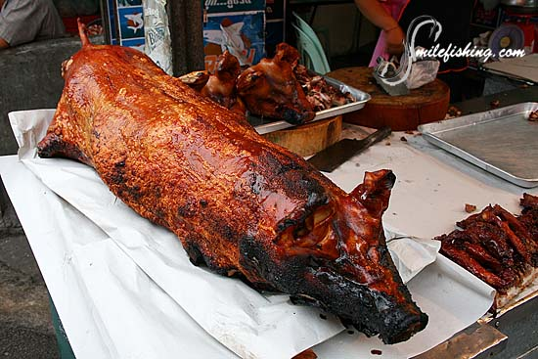
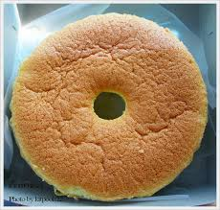
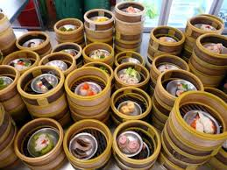
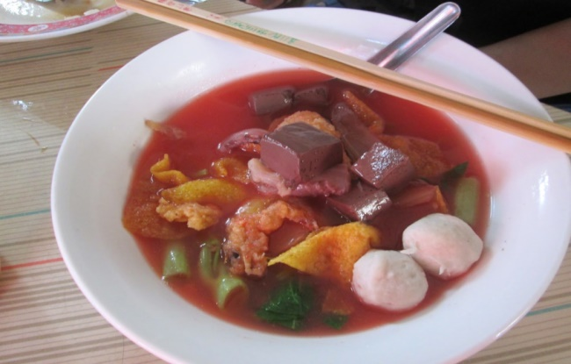
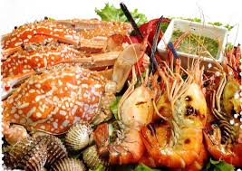
cake
roast pork
What to eat?
Local foods
sea foods
dim sum
noodles

Slide 8
conversation
Tourist : Can you tell me what to eat ?
Student: Sure. There are many yummy foods
such as, cake, roast pork, dim sum, noodles, seafood.
Tourist : Nice. I’ll try them. Thank you. Bye!
Student: Goodbye.

Slide 9
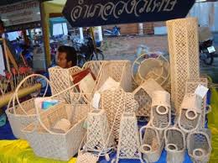
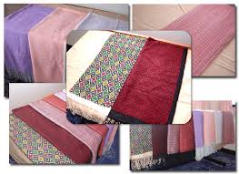
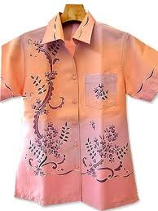
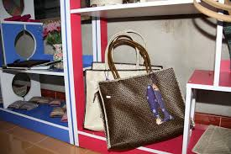
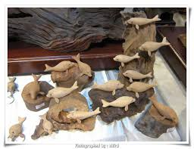
What to buy?
basketwork
Local products
( O- Top)
woven clothes
Batik clothes
handbag
wood carving

Slide 10
Tourist: Can you tell me what to buy ?
Students: Sure. There are many
products, such as woven
clothes, Batik clothes,
wood carving, basketwork.
Tourist : That’s nice. Thank you.
Goodbye!
Student : You’re welcome. Bye.

Slide 11
Exercise: choose the given words put in the blank
Can great where sure Welcome places Goodbye.
Student : __________ to Trang.
Tourist : Thank you . _____ you tell me ______ to
go ?
Student :____. There are many _____ to go
such as Pak Meng Beach , Khao Kop
Cave, Morakot Cave, Sai Rung Waterwall
and Mook Island.
Tourist : Wow! _____. Thank you , Goodbye.
Student : You’re welcome . …….!

Slide 15
Greeting Song
(ครูประไพ บุญญานุเคราะห์ ผู้แต่ง)
A: Good morning and how are you ?
B: I’m fine thank you and how about you?
A: I’m fine thank you , so much.
B: Oh my smart, you’re welcome, too.
A: I’m glad to meet you here.
B: Oh , yes my dear the same to you.
A: Do you know I miss you so much.
B: Oh! my deep heart and I do ,too .
A: It ’s time to say goodbye.
B: Goodbye , Goodbye and see you again.

